Slide 1


Diversity for All Employees
Family Service Society

Slide 2
Introduction
The American workforce reflects an increasingly diverse population. Organizations like ours must effectively manage diversity in order to attract and retain high-quality employees and create a continually cooperative, creative, and productive work environment.
To get the most from our diverse backgrounds, we must respect one another’s ideas, abilities, and perspectives.
Today, you will learn how you can help promote diversity in our workplace so that we may all contribute to goals and share in successes.

Slide 3
Session Objectives
Identify how we are diverse
Understand the challenges and opportunities of workplace diversity
Help avoid discrimination

Slide 4
Session Outline
What workplace diversity means
How it impacts our organization
Discrimination and diversity
Myths and realities about diversity
Ways to make diversity work

Slide 5

Facts About Diversity
1/3 of today’s American workforce is made up of minorities. More than 10% is made up of people aged 55 or older, and almost half is made up of women.
In 2020, Census Bureau estimates over 40% of the workforce will consist of minorities.
In 2050, minorities will approach 50% of the American workforce, and the number of workers age 55 and older will jump to almost 20%.

Slide 6

How Are We Diverse?
Race
Gender
Age
Education
Cultural background
Physical abilities
Sexual Orientation

Slide 7
How Are We Diverse?
Race is the common identifier when talking about minorities, but even people of the same race can be very different from one another.
Gender is also often referred to with diversity, but again, not all men nor all women are alike.
Age is an ever-shifting demographic, because as long as employees stay in the workforce, they will eventually hit every age demographic.

Slide 8
How Are We Diverse?
Education needs to be weighed with experience on the job.
Cultural background includes holiday celebrations, languages spoken in the home or by older relatives, and interactions between young people and elders.
Physical abilities and disabilities include obvious talents or impairments as well as hidden talents or learning disabilities.
Sexual orientation can be different from one person to the next, so people of all sexual orientations should be welcome.

Slide 9

Your Diversity History
Parents are the number one influence on children. What messages did your parents send directly or indirectly about people who are different?
Teachers, whether in school, at church, in clubs, in the gym, or on the playing field, also influence the way kids think during their formative years.
Peers become more and more of an influence as kids grow into their teen years. What messages did you receive from your “crowd?”
Media continues to influence us all our lives no matter if it’s newspapers and magazines, radio, television, movies, or advertisements.

Slide 10
Challenges
1. Getting used to differences. Employees need to be able to get used to interacting and working with people who behave or work differently from them or from what they’re used to. It is important to realize that different is a neutral term. It doesn’t mean better or worse – it just means different.
2. Coordinating work styles. Once differences are accepted, it’s a matter of coordinating work styles. This task requires constant and effective communication.

Slide 11
Challenges
3. Learning to communicate. Learning to communicate across cultural and language differences is a big challenge for everyone. Use positive communication skills and be open to new ideas.
4. Developing flexibility. To be productive in a diverse environment, employees need to be flexible and willing to try different, perhaps unfamiliar, approaches.
5. Adapting to change. Being able to adapt to change is another challenge that diversity presents. Everyone needs to keep an open mind on the job and look at every change as a chance to do the job better.

Slide 12

Challenges
Don’t view differences as BARRIERS. View them as OPPORTUNITIES.

Slide 13

Opportunities
Attracts and keeps quality employees
  Creating a welcoming and diverse workplace where all employees feel empowered and supported in their career goals is the best way to attract quality employees—and the best way to keep them.

Slide 14
Opportunities
Increases employee morale. A diverse workplace also benefits the bottom line by enhancing employee morale. When employees feel and see that diversity is appreciated and promoted in the workplace, they generally feel better about their jobs and their employers, consequently driving productivity and service standards upward.
Maximizes productivity. A smoothly functioning diverse workforce maximizes productivity, as everyone contributes to the best of his or her abilities.

Slide 15
Opportunities
Improves decision-making. The saying goes that there is great wisdom in the counsel of many. Having a variety of opinions improves the decision-making process because issues are considered from many different angles.
Raises the County’s profile. Gaining a reputation as a fair and equitable place to work will raise the County’s profile in the community.

Slide 16

Discrimination and Diversity
There should not be unequal opportunity in employment decisions as they relate to:
  Recruitment, hiring, and firing
  Pay and benefits
  Promotions, transfers, layoffs
  Training and apprenticeships
  Retirement plans and disability leave

Slide 17

Harassment and Diversity
Slurs or “jokes”
  Harassment includes slurs or “jokes,” offensive comments, or other verbal or physical conduct based on an employee’s race, national origin, religion, sex, or age. Such harassment is illegal if it creates an intimidating, hostile, or offensive work environment, or interferes with a person’s work performance.

Slide 18
Who’s Diverse?
Tiger Woods: Asian, black, male, 40-something, golfer
Jennifer Lopez: Hispanic, female, 40-something, singer/actress
Russell Crowe: White, male, Australian, over the age of 50, actor
Barbra Streisand: White, female, Jewish, over the age of 50, singer/actress

Slide 19
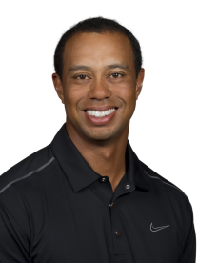
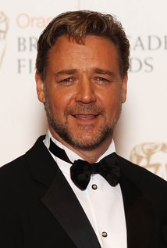
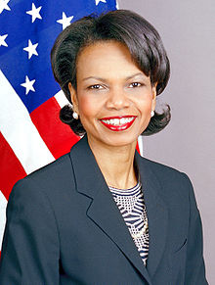
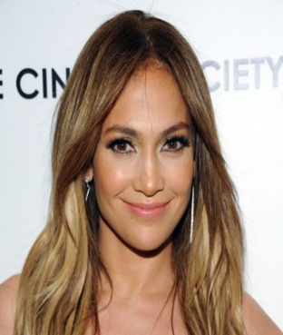
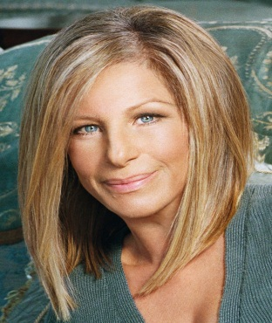
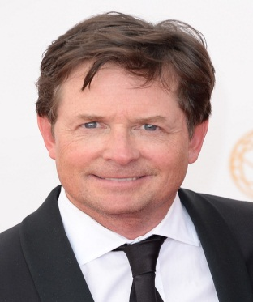
Who’s Diverse?
Condoleeza Rice: Black, female, over the age of 50, professor and politician
Michael J. Fox: White, male, has Parkinson’s Disease, over the age of 50, actor and advocate

Slide 20
Myth or Reality?
People of the same minority group naturally get along better with one another than with those of different groups.
  People of a minority group do not necessarily relate to one another better than they relate to people of a majority group. Diversity exists within every group regardless of skin color, gender, or age.

Slide 21
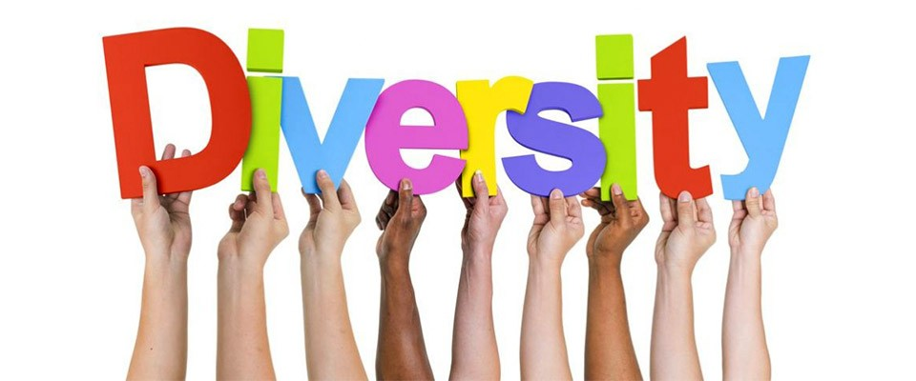
Myth or Reality?
Diversity programs benefit only minorities.
  Diversity programs do include white males. These programs are intended to treat everyone in the workplace fairly and equally.

Slide 22
Making Diversity Work
Learn names and use them frequently
  Learn the names of your co-workers and others with whom you conduct business. Use them frequently when you work together to give a personal touch that shows you recognize everyone’s individuality.
Show interest in co-workers
  When time permits, show interest in your co-workers beyond the job at hand. Ask about cultural celebrations or traditions.

Slide 23
Making Diversity Work
Never assume. Never assume stereotypes about specific groups of people. You wouldn’t appreciate co-workers assuming something about you.
Avoid personal attacks. Avoid personal comments of a derogatory nature.

Slide 24
Making Diversity Work
Approach controversial topics generally. When you must discuss controversial issues in the workplace, approach the topic in a general way; don’t relate it to particular individuals.
Treat genders equally. Make sure you and all employees treat males and females equally and give them equal opportunities.

Slide 25
Making Diversity Work
Avoid sexist comments to either gender
DO NOT guess co-workers’ identities. DO NOT assume the identity or racial affiliation of any individual. DO NOT look at skin tone or hair type to categorize people. DO NOT categorize at all.
Learn—and use—acceptable terms. Learn acceptable terms when working with people who are different from you. “People with disabilities,” for example, instead of “handicapped.”

Slide 26

Making Diversity Work
Use the variety of experiences among co-workers
Respect differences
Look at co-workers’ abilities—not their disabilities
Don’t go along with insensitive comments
Think inclusive—not exclusive

Slide 27
Key Points to Remember
Diversity respects differences
It encourages new ideas and perspectives
It promotes fairness and allows everyone to contribute to goals and share in success
It helps to create a stronger, more successful organization

Slide 28
The End.
Thank you for viewing this training course. If you have any questions or concerns about Diversity, please contact Human Resources.

